Slide 1

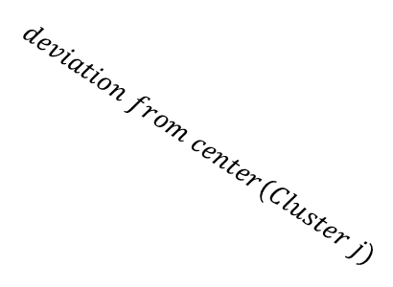




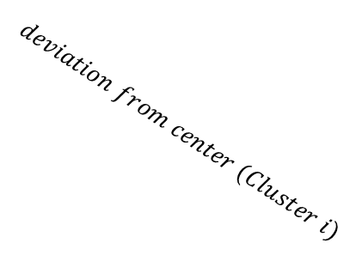
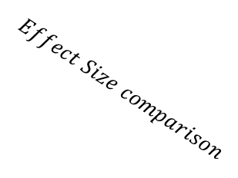
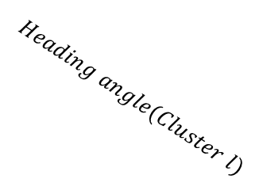
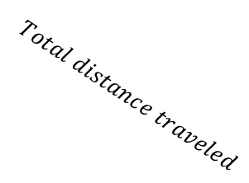
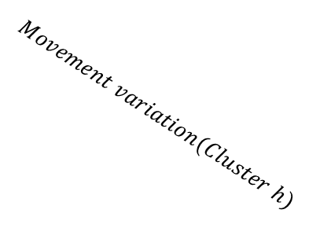

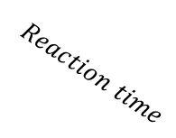
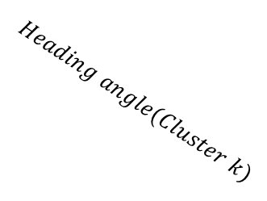
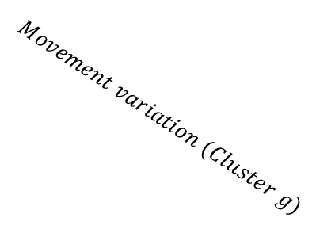


$$Effect Size comparison$$
$$Reach$$
$$Keyboard$$
$$Exploratory$$
$$Confirmatory$$
$$Reaction time$$
$$Movement time$$
$$COM$$
$$Total distance traveled$$
$$Reach area$$
$$RT$$
$$deviation from center (Cluster i)$$
$$deviation from center(Cluster j)$$
$$Movement variation (Cluster g)$$
$$Movement variation(Cluster h)$$
$$Heading angle(Cluster k)$$
$$Heading angle(Cluster l)$$
Permutation + Clustering
Deviation
from center
i
j
Proportion of Z traveled

